Slide 1
Part - III Principles of Electronic Communication

Slide 2
Frequency Modulation

Slide 3
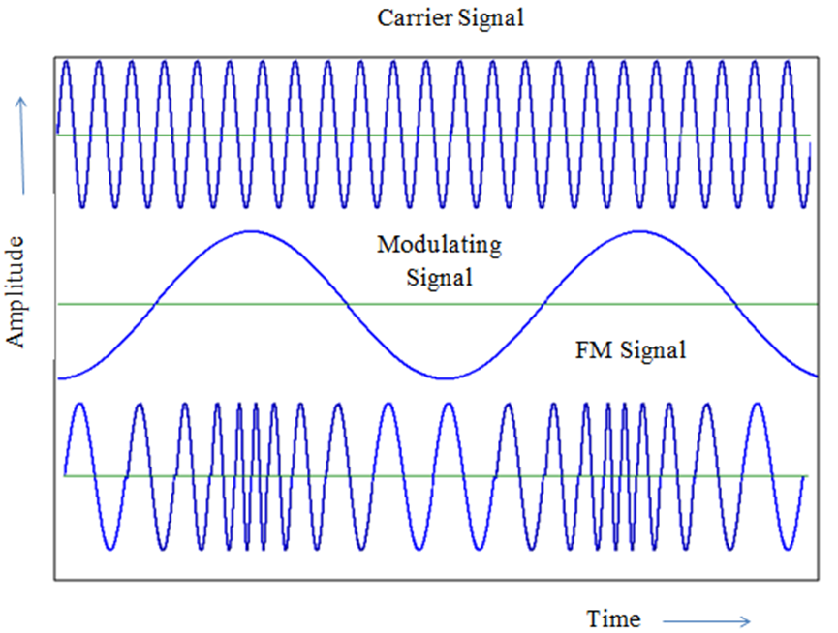
Frequency Modulation
What is FM?
Graphical Illustration of FM
2
Department of Electronics and Communication Engineering, MIT, Manipal
Notes:
Definition of FM
A process of altering the frequency of the carrier signal in accordance with the instantaneous amplitude of the modulating signal.
Graphical Illustration of FM
Modulating Signal:
The message signal or the information signal which is to be transmitted over long distances. Ex: speech , voice, music , video signal etc.,
Carrier Signal:
The high frequency signal that carries the message signal over long distances. Usually it is a high frequency Sinusoidal Signal.
FM Modulated Signal:
The resultant signal obtained in which the carrier frequency varies instantaneously with respect to the amplitude of the message signal. As seen in the diagram above, the FM signal appears to have undergone compression and rarefaction.

Slide 4
Exercises
Given a FM equation V_{FM} (t) =10 cos [ 2 Π 10⁸t + 5 sin(2 Π 15000t) ] , Calculate Carrier frequency. Modulating frequency. Frequency deviation. Bandwidth using Carson’s rule.
In an FM system when the audio frequency is 50Hz , modulating voltage is 2.5V , the deviation produced is 5KHz. If the modulating voltage is now increased to 7.5V, calculate the new value of frequency deviation. If the Am voltage is raised to 10V while the modulating frequency is dropped to 250Hz, what is the frequency deviation produced. Also calculate modulation index in each case.

Slide 5
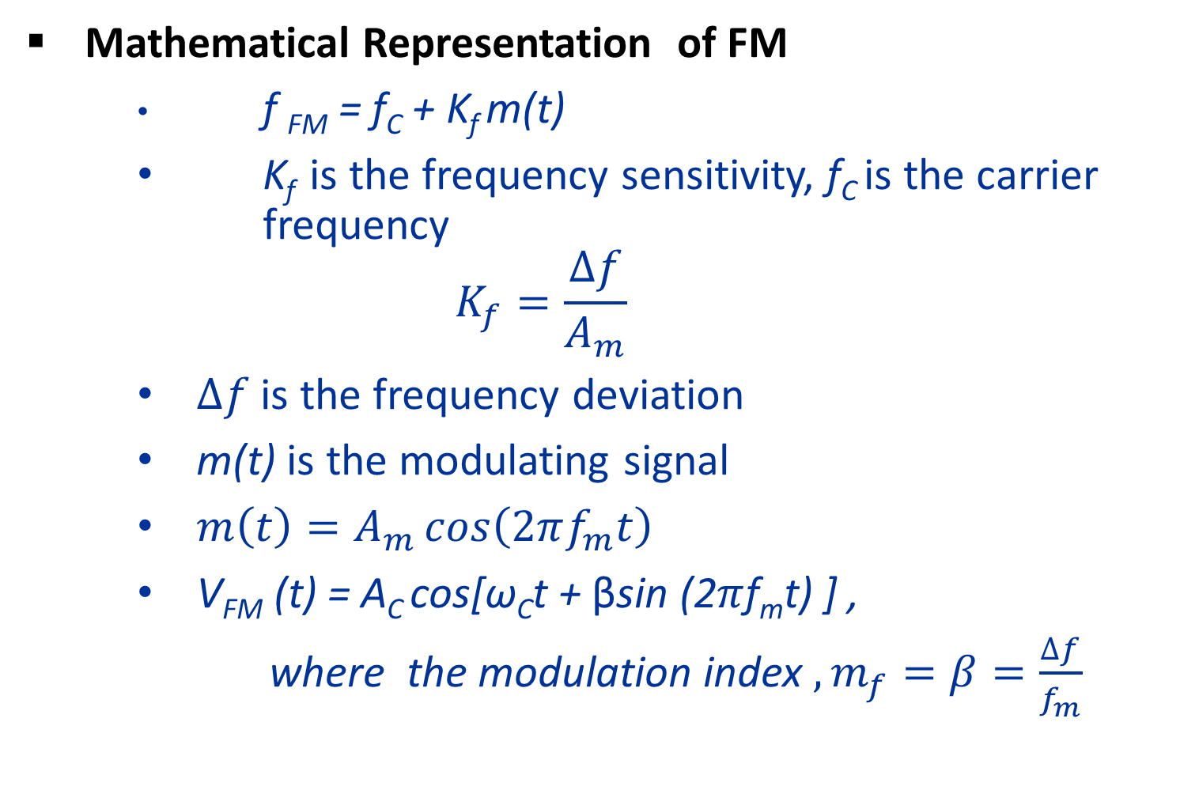
Mathematical Representation of FM
f _{FM} = f_{C} + K_{f} m(t)
K_{f} is the frequency sensitivity, f_{C} is the carrier frequency
$$K_{f}=\frac{∆f}{A_{m}}$$
$∆f$ is the frequency deviation
m(t) is the modulating signal
$m\left(t\right)=A_{m}\cos\left(2πf_{m}t\right)$
V_{FM} (t) = A_{C} cos[ω_{C}t + βsin (2$π$f_{m}t) ] ,
where the modulation index $, m_{f}=β=\frac{∆f}{f_{m}}$

Slide 6

Frequency Modulation Contd.,
Spectrum of FM wave
By Carson’s rule,$Bandwidth≈2\left(∆f+f_{m}\right)$
Notes:
in FM, the actual bandwidth required may be very large due to the spreading of sidebands with increase in modulation index. Therefore it is necessary to limit the bandwidth of a FM signal so as to avoid its interference with the neighboring radio station frequency. Therefore Carson’s rule is used which states that 98% of the signal power is contained within a bandwidth given by twice the sum of modulating frequency and frequency deviation.

